Slide 1

West Sussex Local Outbreak Control Plan
West Sussex County Council
West Sussex COVID-19 Weekly Data
This pack brings together information relating to COVID-19 in West Sussex.
West Sussex County Council Public Health Department monitors information on a daily basis, summary packs will be published weekly. Links are provided to the public data sources available, a summary of current sources is provided at the end of this pack.
Local authorities have access to some information that is not in the public domain, this may be due to small numbers or data being provisional.
Contact
publichealth@westsussex.gov.uk
Pack Date: 22 July 2020

Slide 2
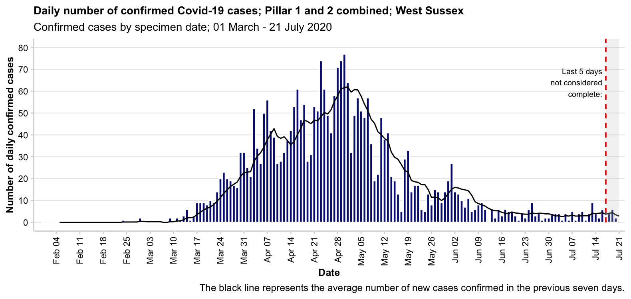
West Sussex Local Outbreak Control Plan – Confirmed Cases
West Sussex County Council
Pillar 1 includes NHS testing, such as tests of people being admitted to hospital or being discharged to a health/care home setting, pre-operative testing etc.
Pillar 2 is wider community testing
The most recent cases may not be complete due to a time lag in reporting
Source: https://coronavirus.data.gov.uk/
Pack Date: 22 July 2020

Slide 3
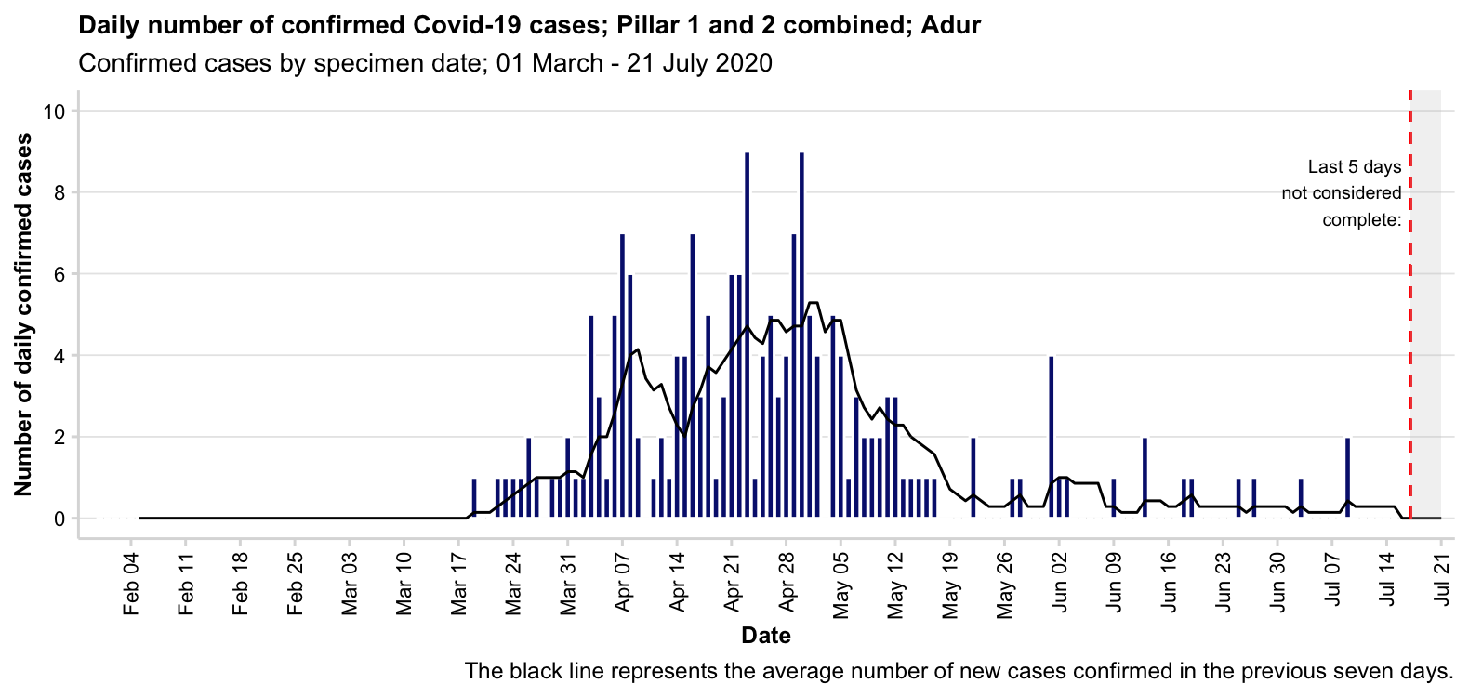
West Sussex Local Outbreak Control Plan – Confirmed Cases
West Sussex County Council
Pillar 1 includes NHS testing, such as tests of people being admitted to hospital or being discharged to a health/care home setting, pre-operative testing etc.
Pillar 2 is wider community testing
The most recent cases may not be complete due to a time lag in reporting
Source: https://coronavirus.data.gov.uk/
Pack Date: 22 July 2020

Slide 4
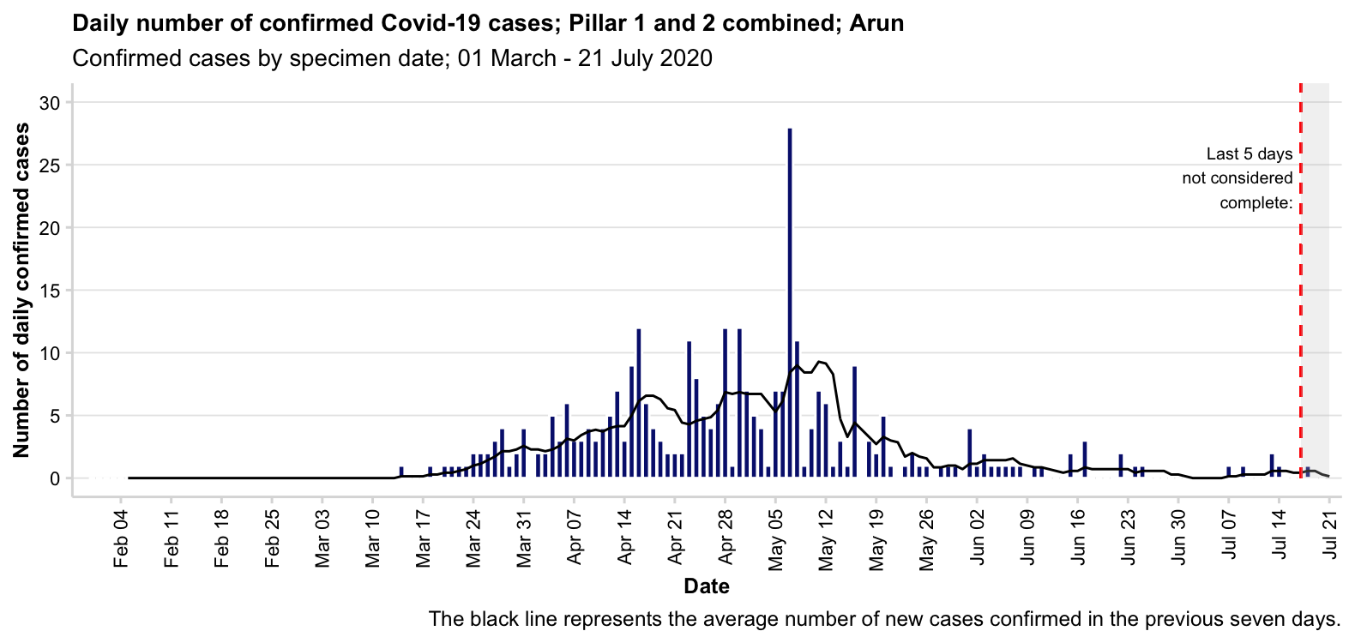
West Sussex Local Outbreak Control Plan – Confirmed Cases
West Sussex County Council
Pillar 1 includes NHS testing, such as tests of people being admitted to hospital or being discharged to a health/care home setting, pre-operative testing etc.
Pillar 2 is wider community testing
The most recent cases may not be complete due to a time lag in reporting
Source: https://coronavirus.data.gov.uk/
Pack Date: 22 July 2020

Slide 5
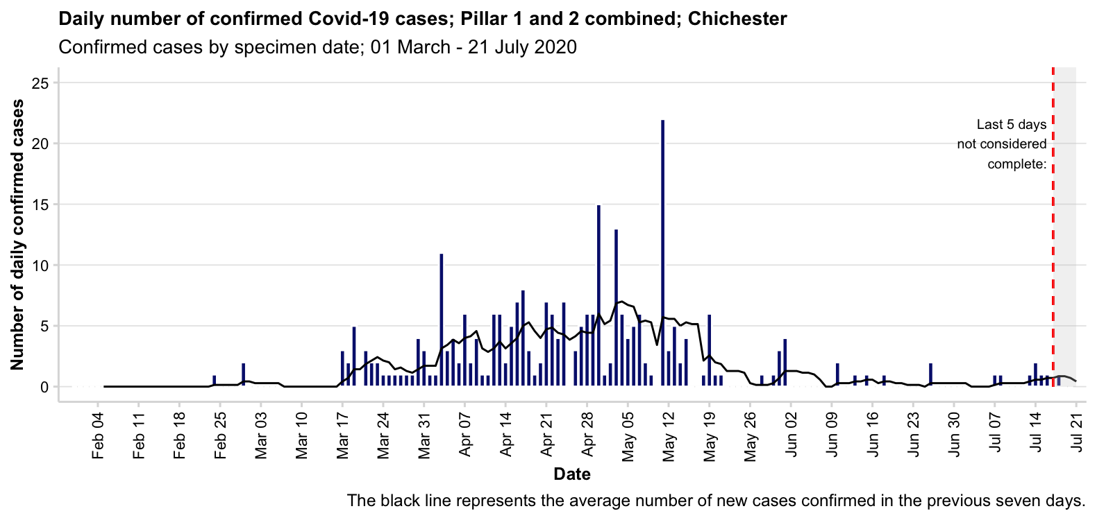
West Sussex Local Outbreak Control Plan – Confirmed Cases
West Sussex County Council
Pillar 1 includes NHS testing, such as tests of people being admitted to hospital or being discharged to a health/care home setting, pre-operative testing etc.
Pillar 2 is wider community testing
The most recent cases may not be complete due to a time lag in reporting
Source: https://coronavirus.data.gov.uk/
Pack Date: 22 July 2020

Slide 6
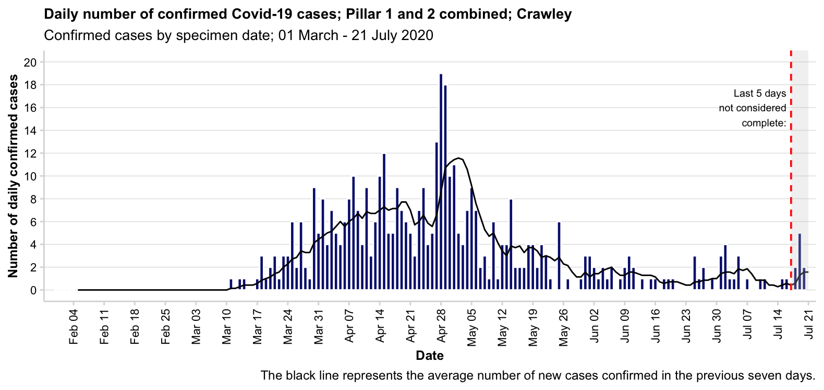
West Sussex Local Outbreak Control Plan – Confirmed Cases
West Sussex County Council
Pillar 1 includes NHS testing, such as tests of people being admitted to hospital or being discharged to a health/care home setting, pre-operative testing etc.
Pillar 2 is wider community testing
The most recent cases may not be complete due to a time lag in reporting
Source: https://coronavirus.data.gov.uk/
Pack Date: 22 July 2020

Slide 7
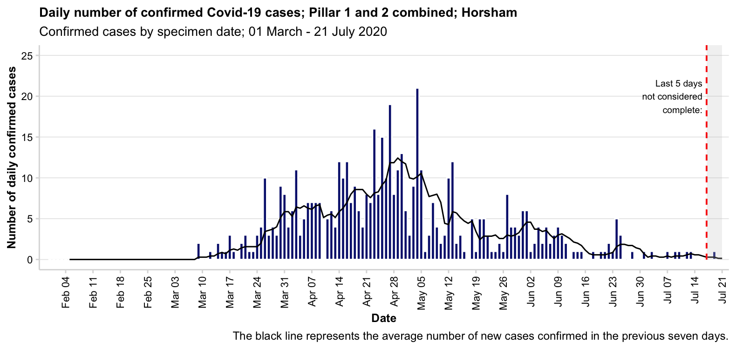
West Sussex Local Outbreak Control Plan – Confirmed Cases
West Sussex County Council
Pillar 1 includes NHS testing, such as tests of people being admitted to hospital or being discharged to a health/care home setting, pre-operative testing etc.
Pillar 2 is wider community testing
The most recent cases may not be complete due to a time lag in reporting
Source: https://coronavirus.data.gov.uk/
Pack Date: 22 July 2020

Slide 8
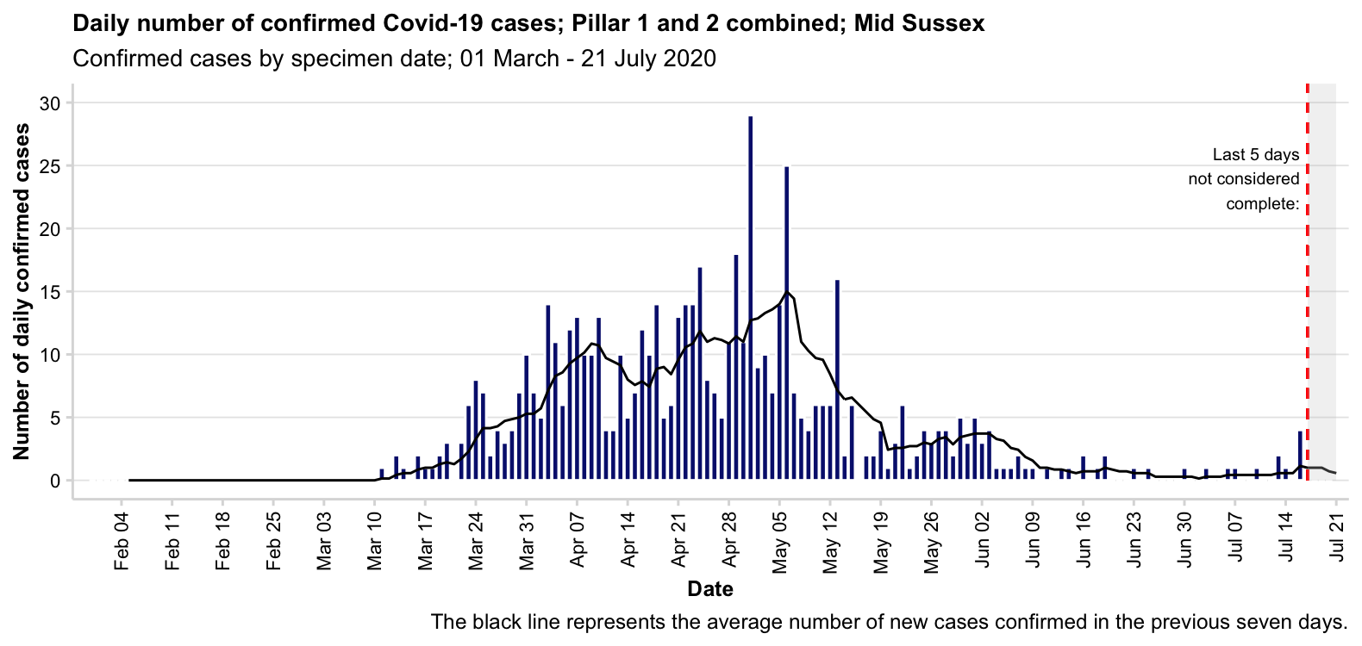
West Sussex Local Outbreak Control Plan – Confirmed Cases
West Sussex County Council
Pillar 1 includes NHS testing, such as tests of people being admitted to hospital or being discharged to a health/care home setting, pre-operative testing etc.
Pillar 2 is wider community testing
The most recent cases may not be complete due to a time lag in reporting
Source: https://coronavirus.data.gov.uk/
Pack Date: 22 July 2020

Slide 9
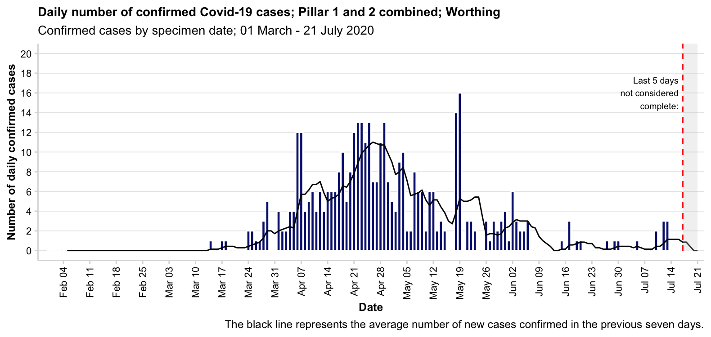
West Sussex Local Outbreak Control Plan – Confirmed Cases
West Sussex County Council
Pillar 1 includes NHS testing, such as tests of people being admitted to hospital or being discharged to a health/care home setting, pre-operative testing etc.
Pillar 2 is wider community testing
The most recent cases may not be complete due to a time lag in reporting
Source: https://coronavirus.data.gov.uk/
Pack Date: 22 July 2020

Slide 10
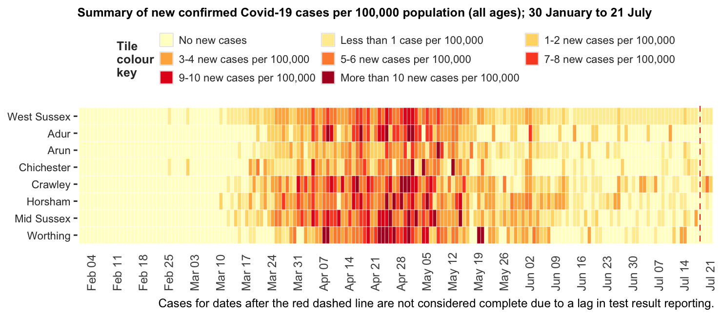
West Sussex Local Outbreak Control Plan – Summary Confirmed Cases per 100,000 Population
West Sussex County Council
Pack Date: 22 July 2020
Source: https://coronavirus.data.gov.uk/

Slide 11
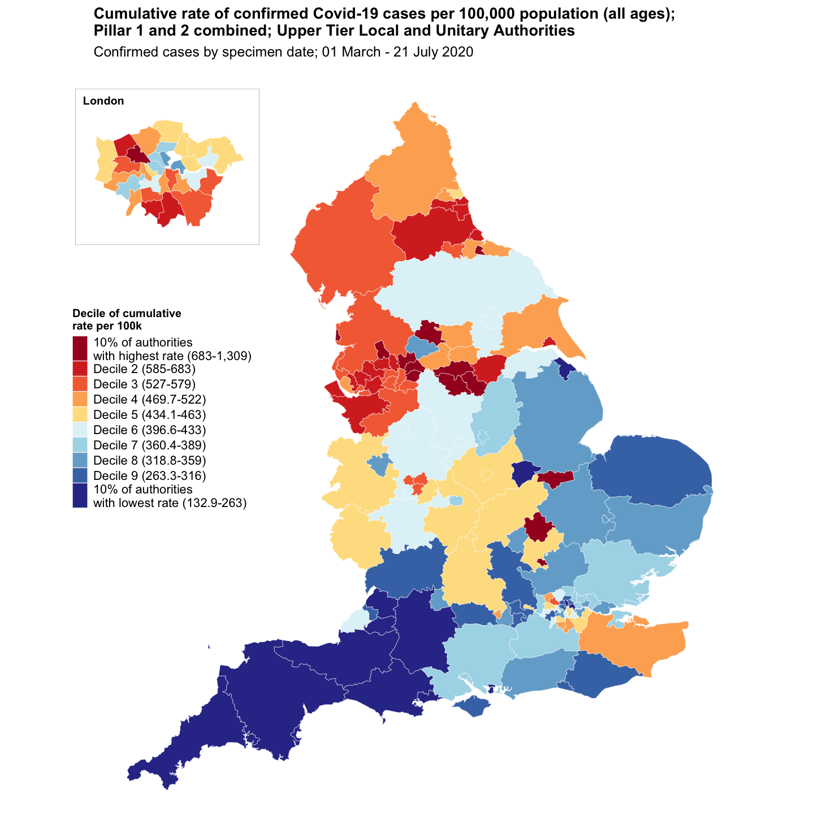
West Sussex Local Outbreak Control Plan
West Sussex County Council
Confirmed Cases UTLA
Cumulative Cases as at 21st July 2020
Name | Cases | Rate per 100,000 residents | Local Authority Rank (out of 149) where 1 = Highest Rate per 100,000 | Decile of rate per 100,000
West Sussex | 2,744 | 317.6 | 119th | Decile 8
England | 254,120 | 451.5 | - | -
South East region | 34,694 | 377.9 | - | -
Source: https://coronavirus.data.gov.uk/
Data accessed July 21st 2020
What is a decile?
Every area in England is ranked from highest to lowest rate of confirmed COVID-19 cases per 100,000 population and then areas are divided 10 groups each representing 10% of the areas in England.
West Sussex is in the 8th decile.
Pack Date: 22 July 2020

Slide 12
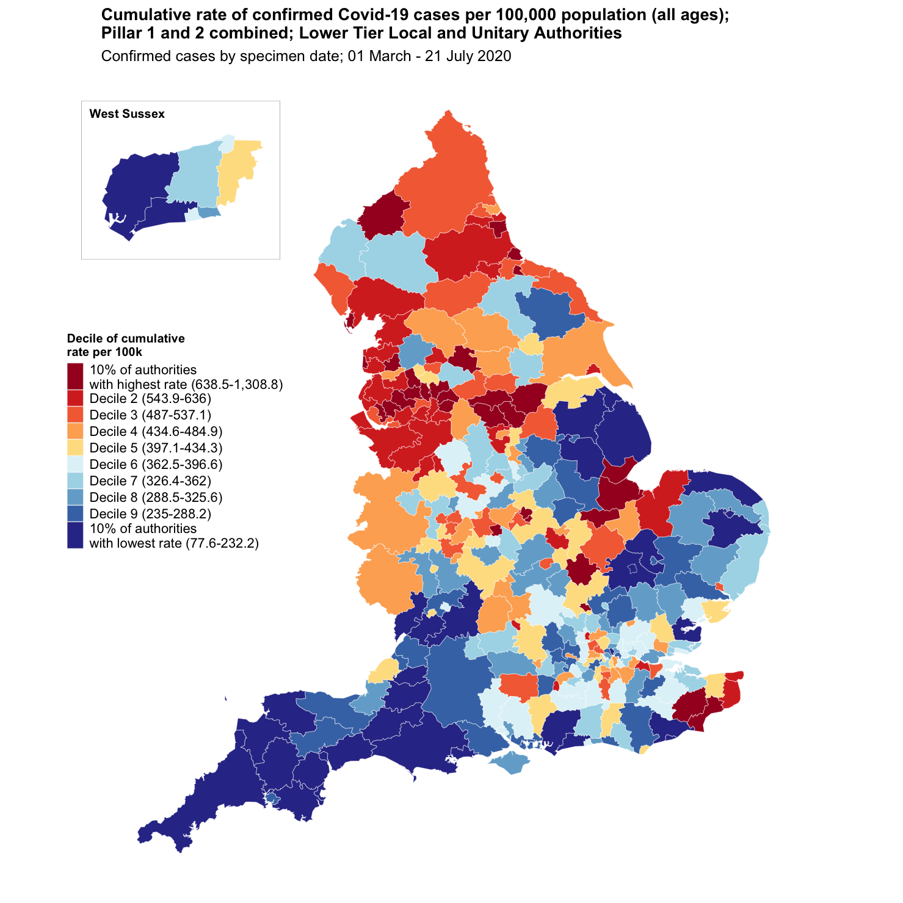
West Sussex Local Outbreak Control Plan
West Sussex County Council
Confirmed Cases LTLA
Cumulative Cases as at 19th July 2020
Name | Cases | Rate per 100,000 residents | Local Authority Rank (out of 315) where 1 = Highest Rate per 100,000 | Decile of rate per 100,000
Adur | 187 | 290.8 | 249th | Decile 8
Arun | 325 | 202.2 | 295th | 10% of authorities with lowest rate
Chichester | 277 | 228.7 | 287th | 10% of authorities with lowest rate
Crawley | 444 | 395 | 157th | Decile 6
Horsham | 515 | 358.2 | 195th | Decile 7
Mid Sussex | 602 | 398.6 | 154th | Decile 5
Worthing | 404 | 365.4 | 185th | Decile 6
West Sussex | 2,754 | 318.8 | - | -
South East region | 34,734 | 378.4 | - | -
England | 254,519 | 452.2 | - | -
Source: https://coronavirus.data.gov.uk/
Data accessed July 21st 2020
What is a decile?
Every area in England is ranked from highest to lowest rate of confirmed COVID-19 cases per 100,000 population and then areas are divided 10 groups each representing 10% of the areas in England.
Pack Date: 22 July 2020

Slide 13
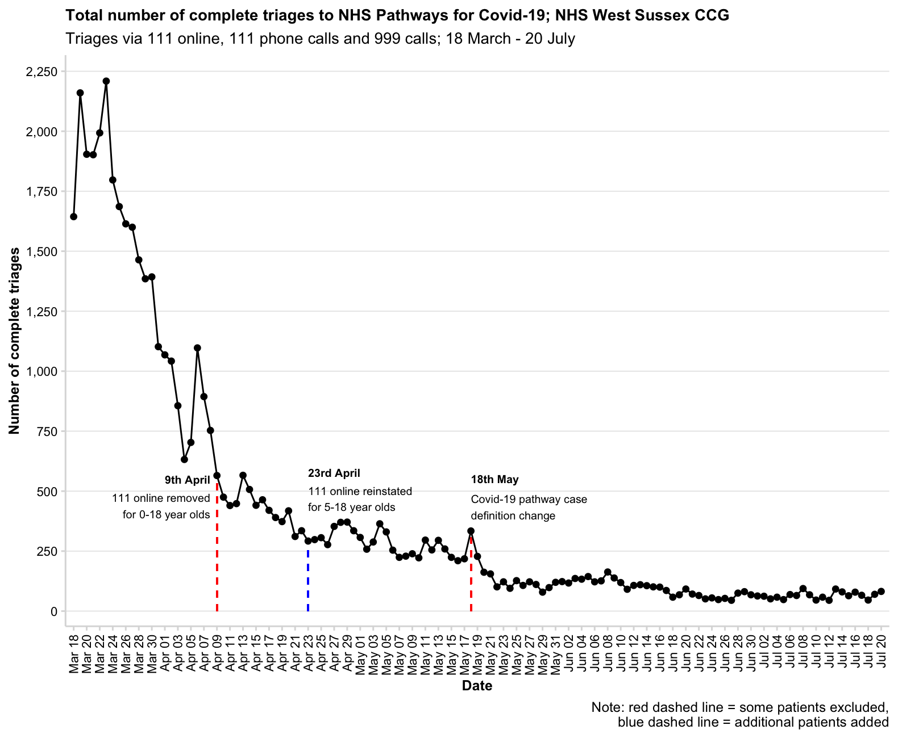
West Sussex Local Outbreak Control Plan – NHS Pathways
West Sussex County Council
In the seven days leading to 20th July there were 487 triages to NHS Pathways for COVID-19, this is an average of 70 each day.
In the last 24 hours there were 82 triages made. This is an increase of 12 triages compared to the previous day (70 triages).
Data based on potential COVID-19 symptoms reported by members of the public to NHS Pathways through NHS 111 or 999 and 111 online.
This provides a view of service contacts and provides early view of people concerned about symptoms. It is not based on the outcomes of tests for coronavirus.
This is not a count of people. In 111 online, any user that starts and launches the COVID-19 assessment services is indicating they may have symptoms of coronavirus.
Source: NHS Digital
Pack Date: 22 July 2020

Slide 14
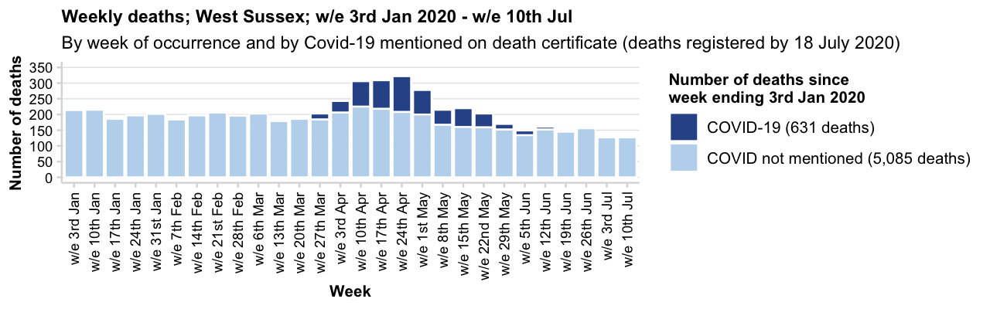
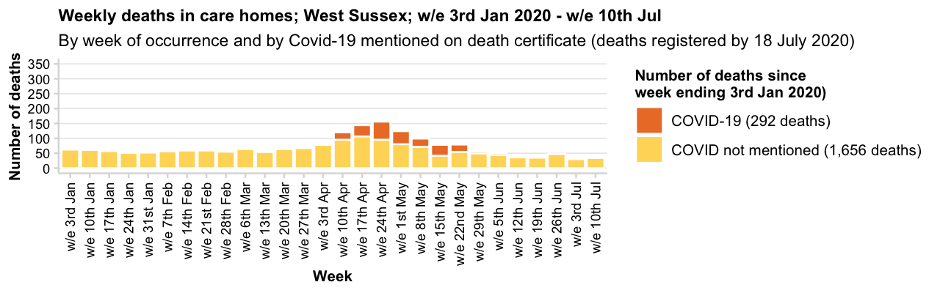
West Sussex Local Outbreak Control Plan – Deaths
West Sussex County Council
Pack Date:
22 July 2020
Source: ONS

Slide 15
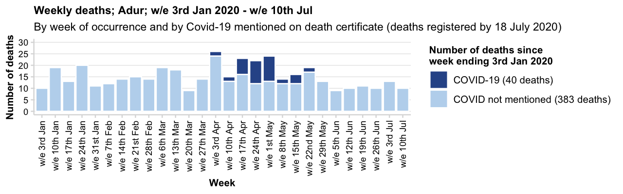
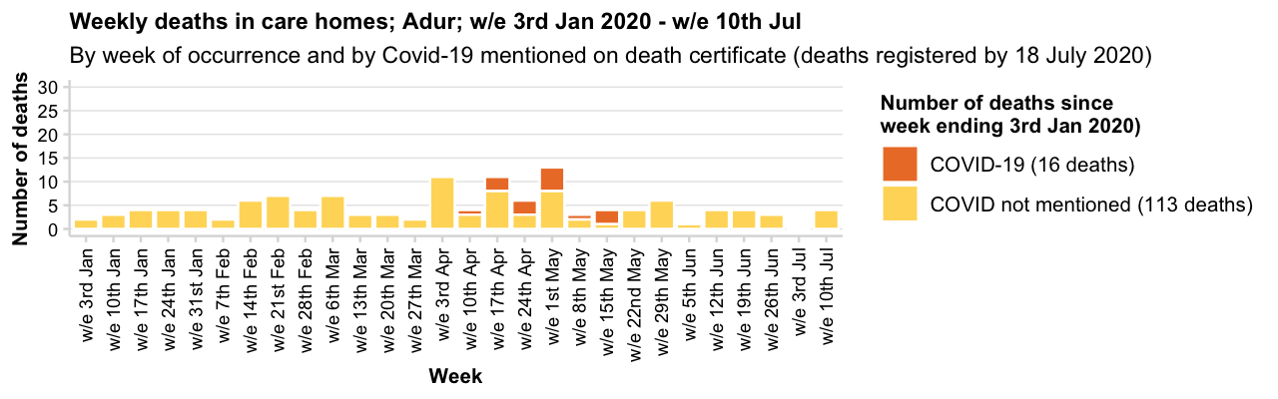
West Sussex Local Outbreak Control Plan – Deaths
West Sussex County Council
Pack Date:
22 July 2020
Source: ONS

Slide 16
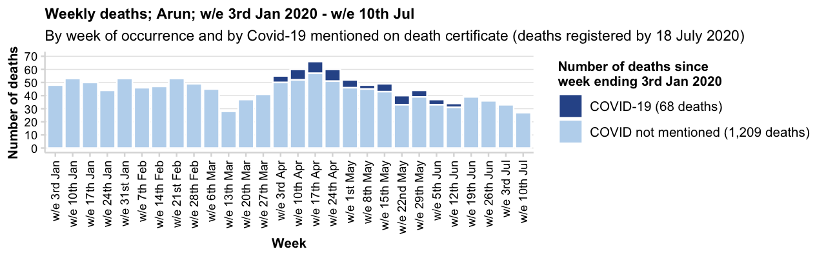
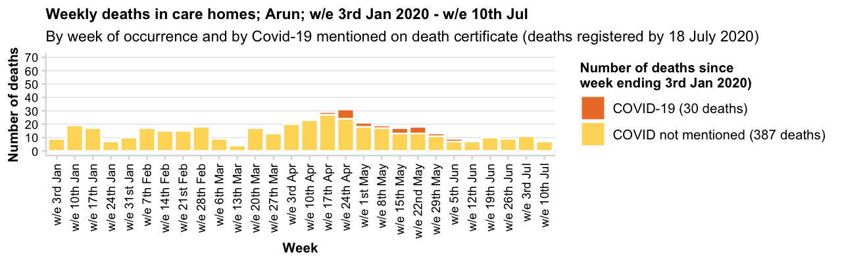
West Sussex Local Outbreak Control Plan – Deaths
West Sussex County Council
Pack Date:
22 July 2020
Source: ONS

Slide 17
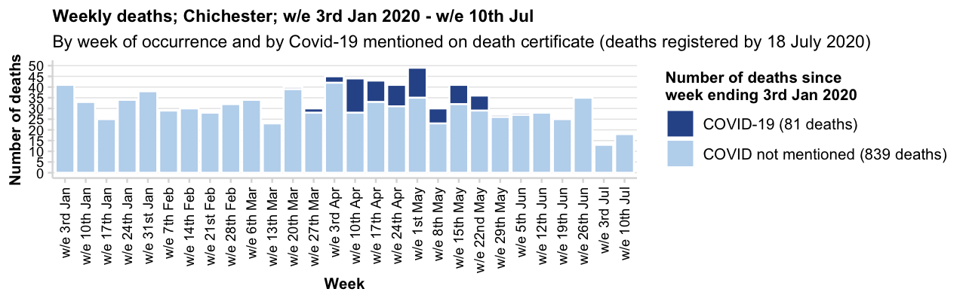
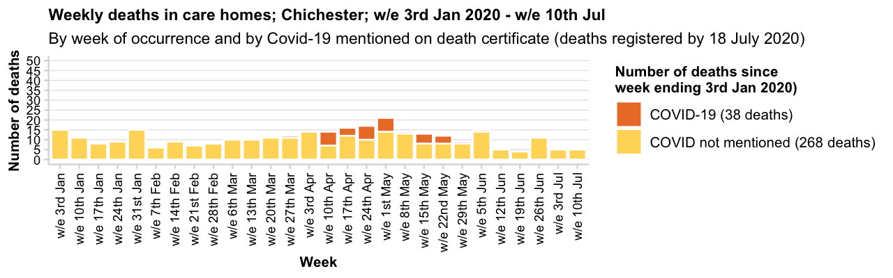
West Sussex Local Outbreak Control Plan – Deaths
West Sussex County Council
Pack Date:
22 July 2020
Source: ONS

Slide 18
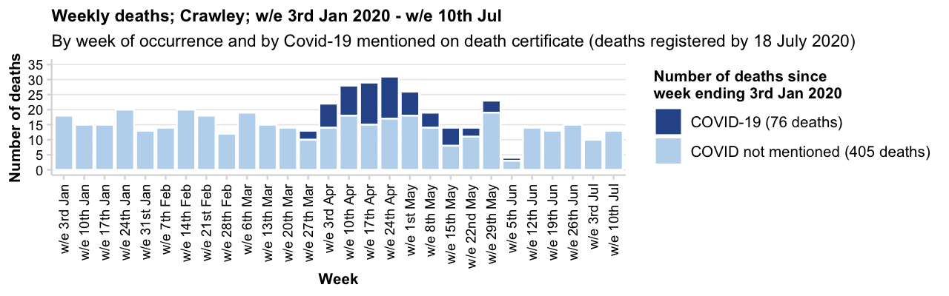
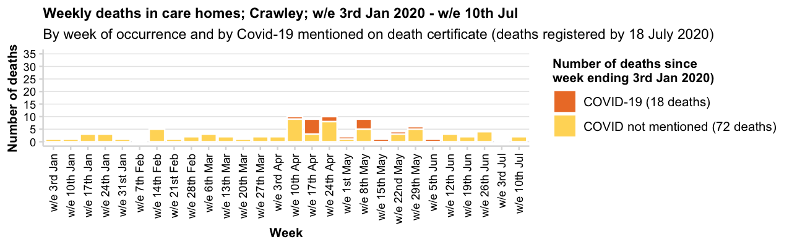
West Sussex Local Outbreak Control Plan – Deaths
West Sussex County Council
Pack Date:
22 July 2020
Source: ONS

Slide 19
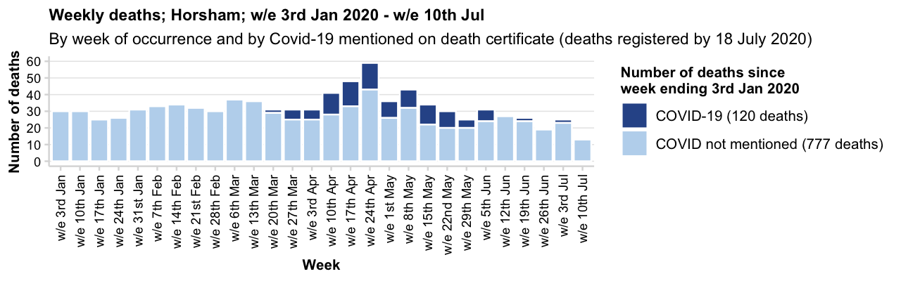
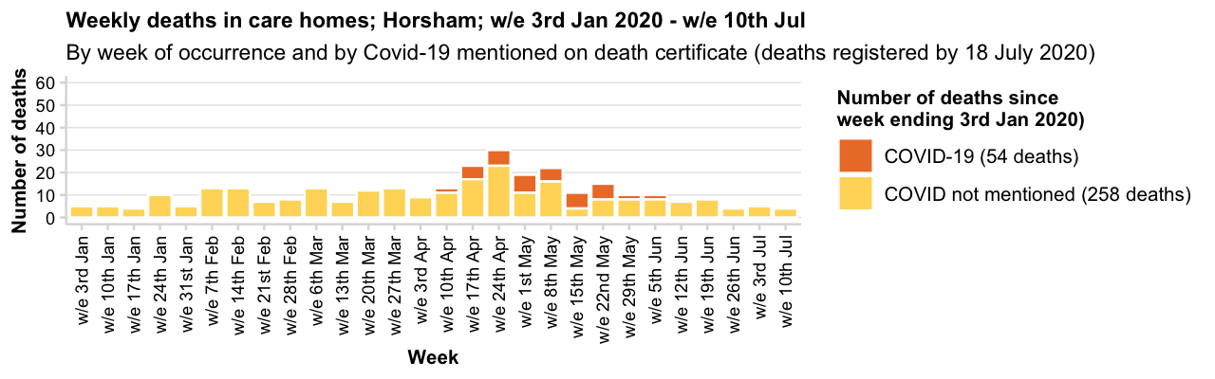
West Sussex Local Outbreak Control Plan – Deaths
West Sussex County Council
Pack Date:
22 July 2020
Source: ONS

Slide 20
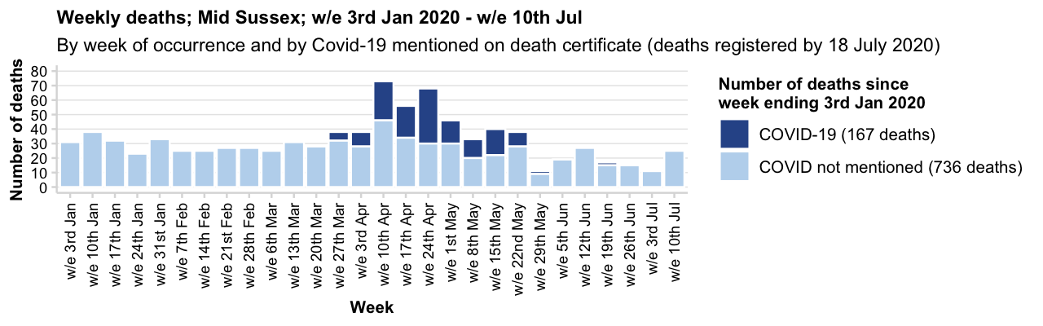
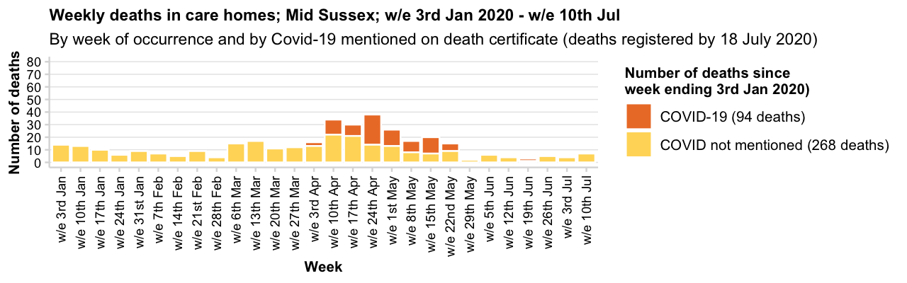
West Sussex Local Outbreak Control Plan – Deaths
West Sussex County Council
Pack Date:
22 July 2020
Source: ONS

Slide 21
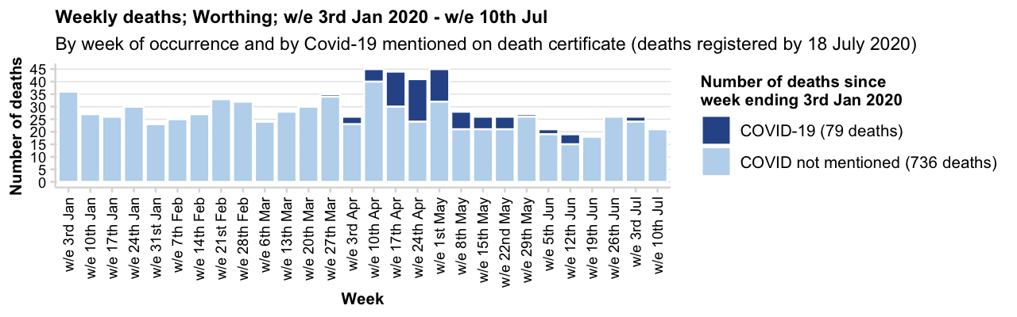
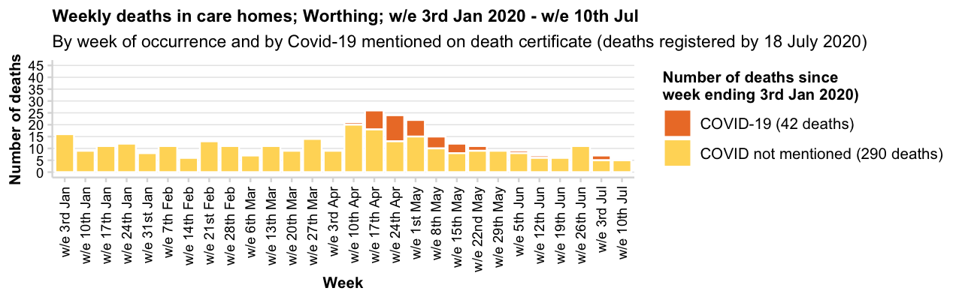
West Sussex Local Outbreak Control Plan – Deaths
West Sussex County Council
Pack Date:
22 July 2020
Source: ONS

Slide 22
West Sussex Local Outbreak Control Plan – Links to data sources available to the public
West Sussex County Council
What |  | Link
Positive cases | Daily update on cases (shown as number of cases and also a rate per 100,000 residents) | https://coronavirus.data.gov.uk/
Positive cases and deaths | Using the cases and deaths tabs in the link - data are available at local authority level | https://coronavirus-staging.data.gov.uk/
NHS Pathways (callers to 111,999 and online 111 assessments) | Information on triages of 999 and 111 callers and completed online assessments which have received a potential coronavirus (COVID-19) final disposition (number and rate per 100,000 population). | https://digital.nhs.uk/dashboards/nhs-pathways
COVID-19: outbreaks in care homes | Weekly number and percentage of care homes reporting a suspected or confirmed outbreak of COVID-19 | Care home outbreaks
Hospital Data | Regional data are in the public domain – click on the healthcare tab for information on admissions, patients in hospital and patients on ventilation | https://coronavirus-staging.data.gov.uk/
Deaths in Hospitals | Daily data on deaths in specific NHS Trusts | https://www.england.nhs.uk/statistics/statistical-work-areas/covid-19-daily-deaths/
Deaths | Weekly data are published by the Office for National Statistics (on Tuesdays). | Weekly death data from ONS
Deaths in care homes notified to CQC | Deaths relating to care home residents, provides some additional detail not available on ONS weekly release | Link to CQC Notification Data
Deaths – additional analysis | The Office for National Statistics have released additional analysis – including analysis below local authority level | Deaths at a sub local authority level
Google Community Data | Community mobility at a local authority level and compare activity (in terms of visits to type of places) with baseline period (3 Jan – 6 Feb 2020). | https://www.google.com/covid19/mobility/
Sources can (and frequently do!) change, access as at time of pack date.
Pack Date: 22 July 2020

